Slide 1
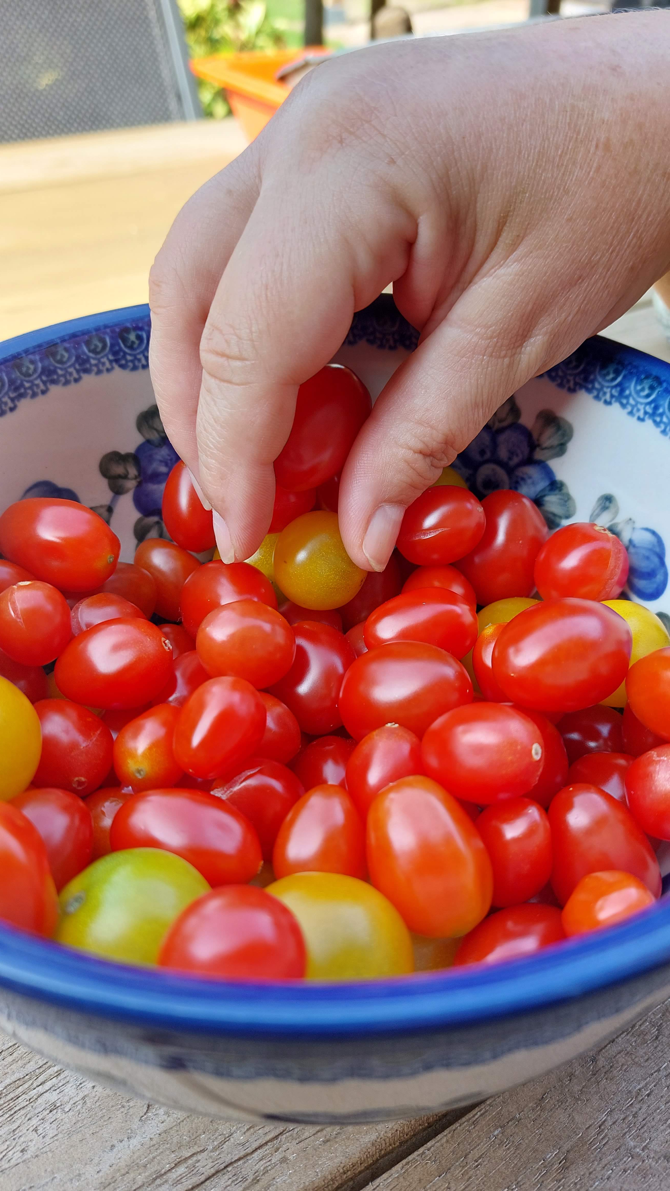


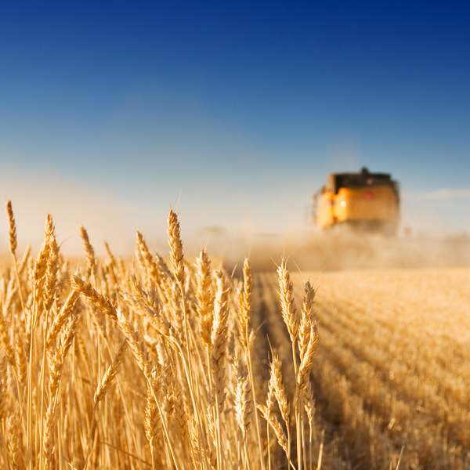
Linear and Generalized Linear Models (4433LGLM6Y)
ANOVA
Meeting 2
Dr. Jos Hageman

Slide 2
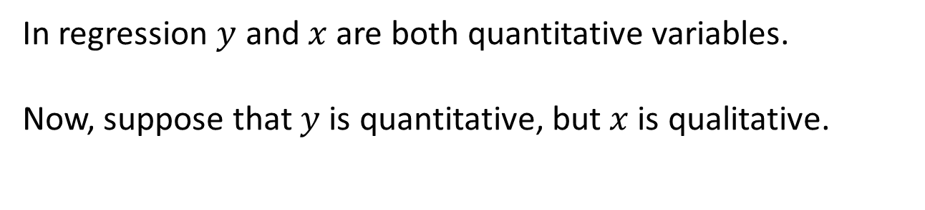

A qualitative explanatory variable
response variable $y$ explanatory variable $x$
?
In regression $y$ and $x$are both quantitative variables.
Now, suppose that $y$ is quantitative, but $x$ is qualitative.

Slide 3



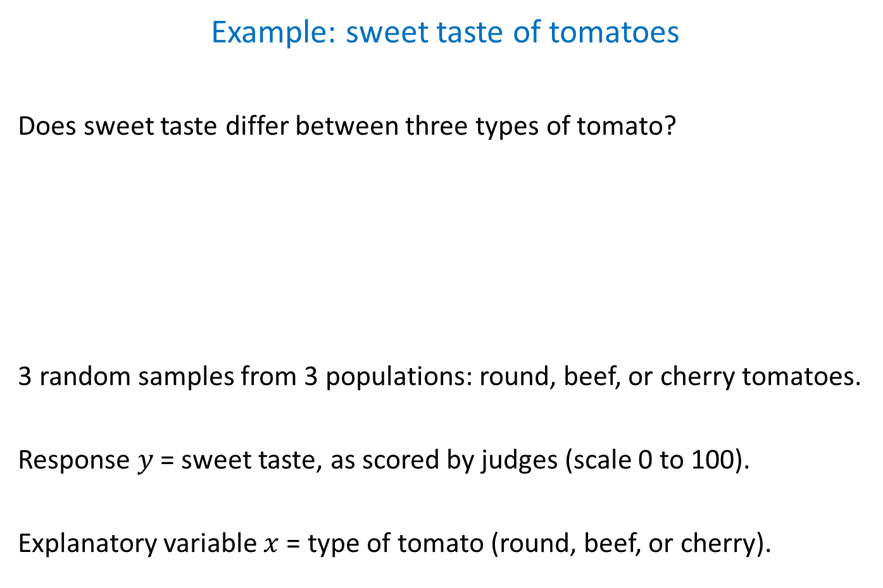
Example: sweet taste of tomatoes
Does sweet taste differ between three types of tomato?
3 random samples from 3 populations: round, beef, or cherry tomatoes.
Response $y$ = sweet taste, as scored by judges (scale 0 to 100).
Explanatory variable $x$ = type of tomato (round, beef, or cherry).
$n_{1}=4 n_{2}=4 n_{3}=4$

Slide 4
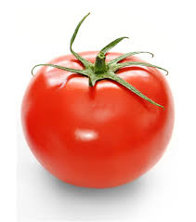

Sweet taste of tomatoes, aim of experiment
taste type
______________
1 25.44 r
2 28.10 r
3 46.46 r
4 36.96 r
5 24.83 b
6 28.47 b
7 48.15 b
8 31.78 b
9 53.42 c
10 70.87 c
11 57.07 c
12 38.08 c
Response $y$ = taste
Explanatory variable $x$ = type of tomato
Aim:
Inference about systematic differences in taste between the three types of tomato.
Provide estimates, standard errors, tests, and confidence intervals.

Slide 5
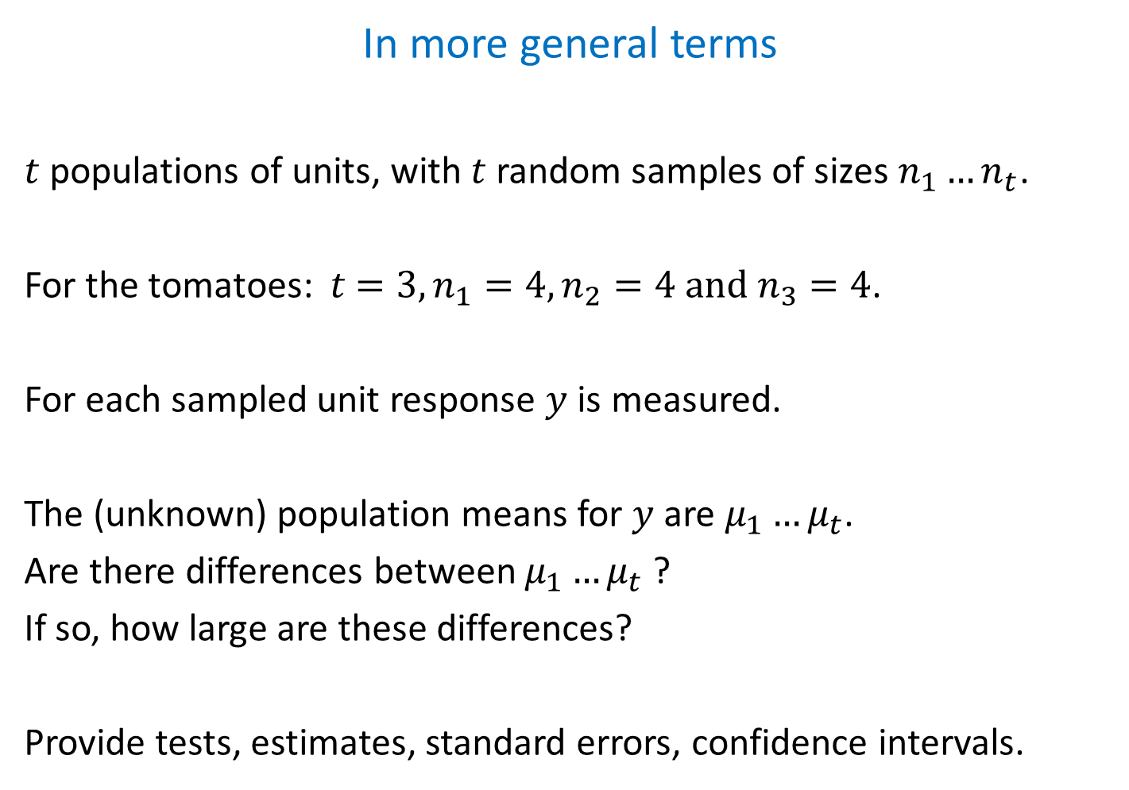
In more general terms
$t$ populations of units, with $t$ random samples of sizes $n_{1}…n_{t}$.
For the tomatoes: $t$ $=3, n_{1}=4,n_{2}=4 and n_{3}=4$.
For each sampled unit response $y$ is measured.
The (unknown) population means for $y$ are $μ_{1}…μ_{t}$.
Are there differences between $μ_{1}…μ_{t}$ ?
If so, how large are these differences?
Provide tests, estimates, standard errors, confidence intervals.
Notes:
t is number of “treatments”

Slide 6

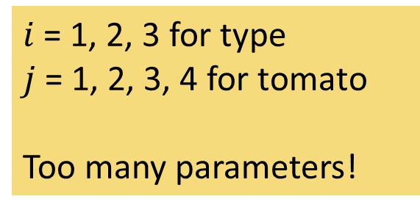
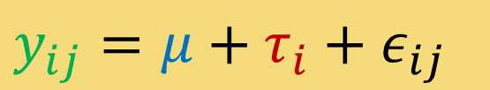



Building the model
$$y_{ij}=μ+τ_{i}+ε_{ij}$$
↑ y
$i$ = 1, 2, 3 for type
$j$ = 1, 2, 3, 4 for tomato
Too many parameters!
$$τ_{3}$$
$$μ$$
$$τ_{1}$$
$$τ_{2}$$
→ x
round beef cherry

Slide 7
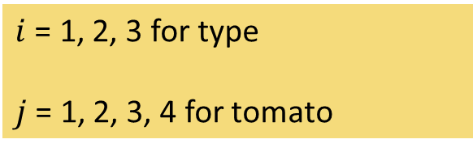

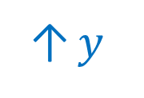




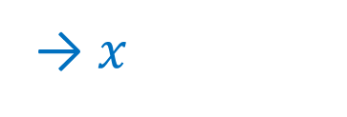
Cornerstone representation
$$y_{ij}=μ+τ_{i}+ε_{ij}$$
↑ $y$
$i$ = 1, 2, 3 for type
$j$ = 1, 2, 3, 4 for tomato
$$μ$$
$$τ_{3}=0$$
type 3 (cherry tomato)
is the reference
$μ$is the mean of type 3
$$τ_{2}$$
$$τ_{1}$$
→ $x$
round beef cherry
Notes:
Remark that there is one parameter too many.

Slide 8
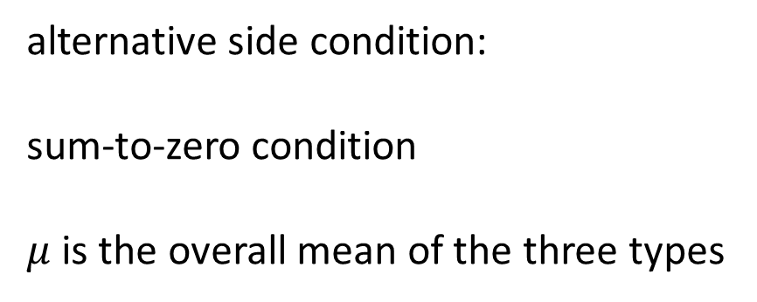
Alternative model representations
alternative side condition:
sum-to-zero condition
$μ$ is the overall mean of the three types
means model
no side condition, just three means

Slide 9




Cornerstone representation: interpretation of model parameters
$$y_{ij}=μ+τ_{i}+ε_{ij}$$
$μ_{1}=μ+τ_{1}$ mean type 1
$μ_{2}=μ+τ_{2}$ mean type 2
$μ_{3}=μ$ mean type 3
$μ=μ_{3}$ reference level
$τ_{1}=μ_{1}−μ_{3}$ type 1 versus 3
$τ_{2}=μ_{2}−μ_{3}$ type 2 versus 3
$i$ = 1, 2, 3 for type
$j$ = 1, 2, 3, 4 for tomato
$$τ_{3}=0$$
type 3 (cherry tomato)
is the reference
type 1 and 2 relative to 3

Slide 10
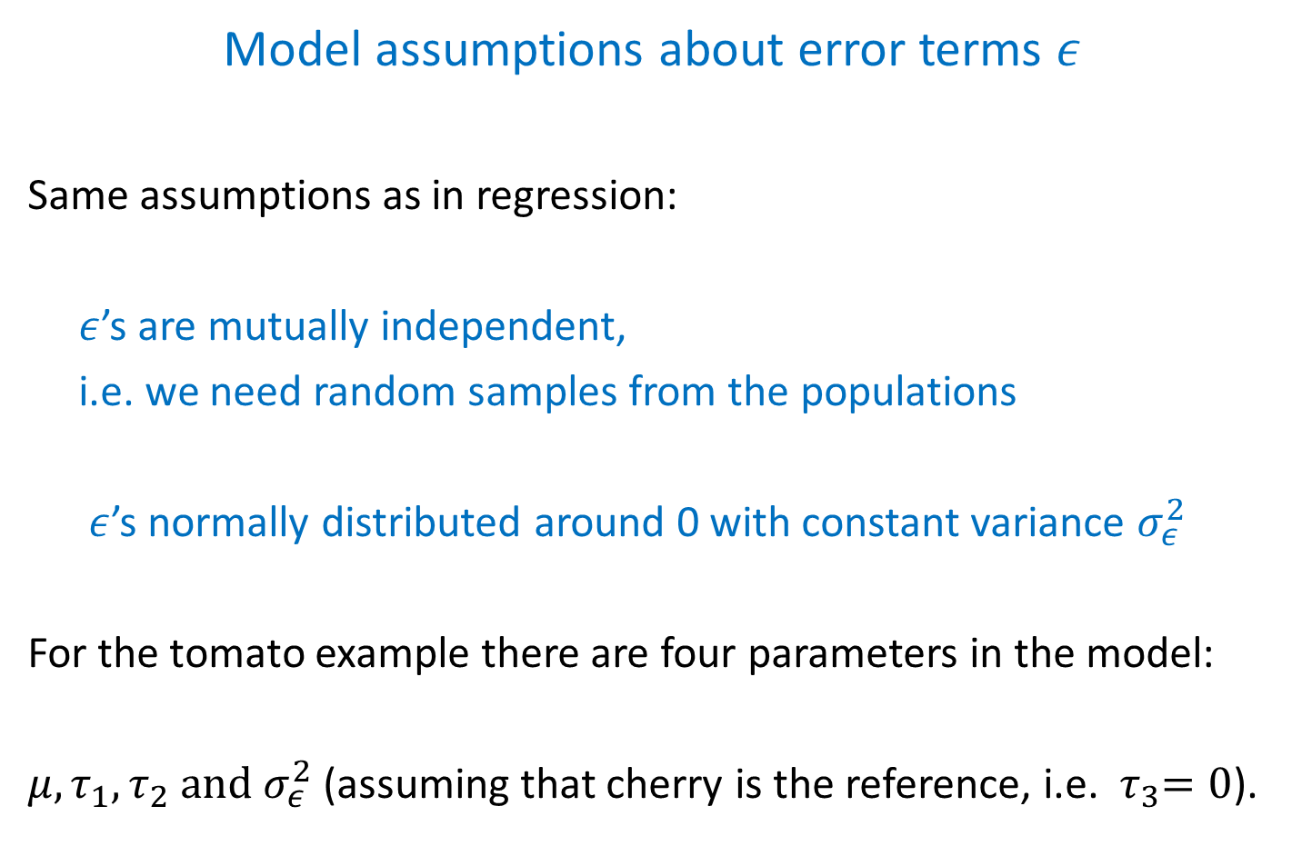
Model assumptions about error terms $ε$
Same assumptions as in regression:
$ε$’s are mutually independent,
i.e. we need random samples from the populations
$ε$’s normally distributed around 0 with constant variance $σ_{ε}^{2}$
For the tomato example there are four parameters in the model:
$μ, τ_{1},τ_{2} and σ_{ε}^{2}$ (assuming that cherry is the reference, i.e. ${ τ}_{3}=0$).

Slide 11
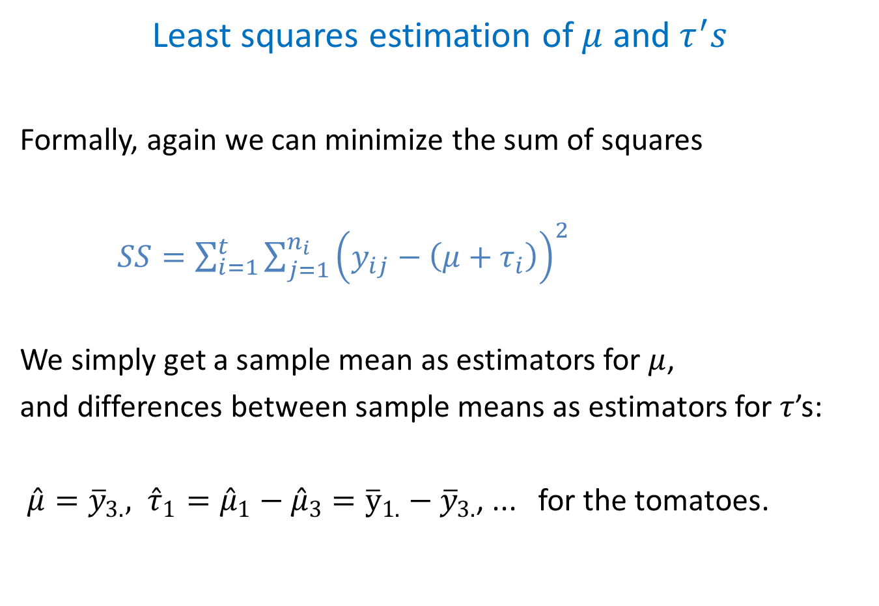
Least squares estimation of $μ$ and $τ^{′}s$
Formally, again we can minimize the sum of squares
$SS=\sum_{i=1}^{t}{\sum_{j=1}^{n_{i}}{{\left(y_{ij}−\left(μ+τ_{i}\right)\right)}^{2}}}$
We simply get a sample mean as estimators for $μ$,
and differences between sample means as estimators for $τ$’s:
${\hat{μ}=\overline{y}}_{3.}, {\hat{τ}}_{1}={\hat{μ}}_{1}−{\hat{μ}}_{3}={\overline{y}}_{1.}−{\overline{y}}_{3.}$, ... for the tomatoes.

Slide 12
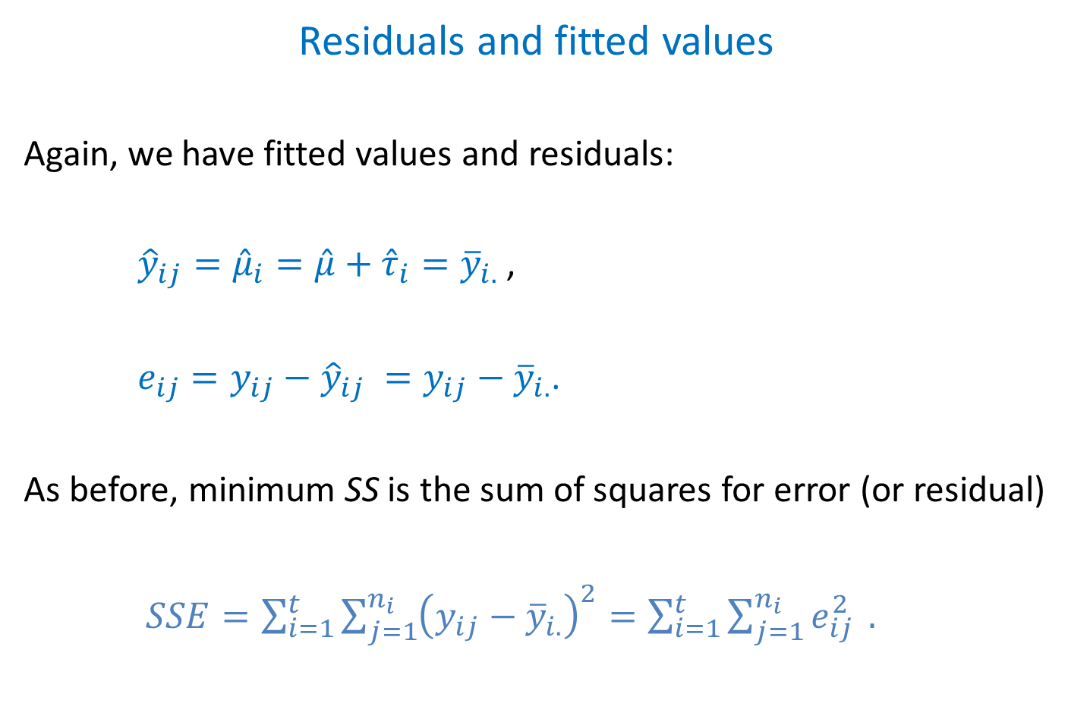
Residuals and fitted values
Again, we have fitted values and residuals:
${\hat{y}}_{ij}={\hat{μ}}_{i}=\hat{μ}+{\hat{τ}}_{i}={\overline{y}}_{i.}$ ,
$e_{ij}=y_{ij}−{\hat{y}}_{ij} =y_{ij}−{\overline{y}}_{i.}$.
As before, minimum SS is the sum of squares for error (or residual)
$SSE=\sum_{i=1}^{t}{\sum_{j=1}^{n_{i}}{{\left(y_{ij}−{\overline{y}}_{i.}\right)}^{2}=\sum_{i=1}^{t}{\sum_{j=1}^{n_{i}}{e_{ij}^{2}}}}} .$

Slide 13
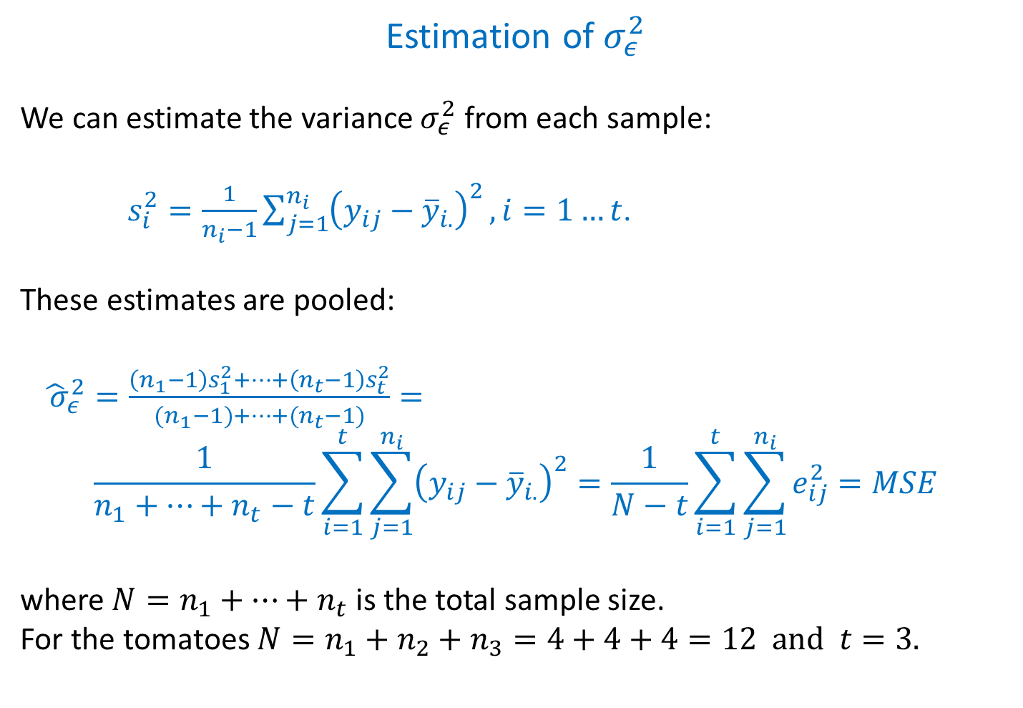
Estimation of $σ_{ε}^{2}$
We can estimate the variance $σ_{ε}^{2}$ from each sample:
$s_{i}^{2}=\frac{1}{n_{i}−1}\sum_{j=1}^{n_{i}}{{\left(y_{ij}−{\overline{y}}_{i.}\right)}^{2}}, i=1…t$.
These estimates are pooled:
${\hat{ σ}}_{ε}^{2}=\frac{\left(n_{1}−1\right)s_{1}^{2}+…+\left(n_{t}−1\right)s_{t}^{2}}{{(n}_{1}−1)+…+{(n}_{t}−1)}=$
$$\frac{1}{n_{1}+…+n_{t}−t}\sum_{i=1}^{t}{\sum_{j=1}^{n_{i}}{{\left(y_{ij}−{\overline{y}}_{i.}\right)}^{2}=\frac{1}{N−t}\sum_{i=1}^{t}{\sum_{j=1}^{n_{i}}{e_{ij}^{2}=MSE}}}}$$
where $N=n_{1}+…+n_{t}$ is the total sample size.
For the tomatoes $N=n_{1}+n_{2}+n_{3}=4+4+4=12 and t=3.$

Slide 14
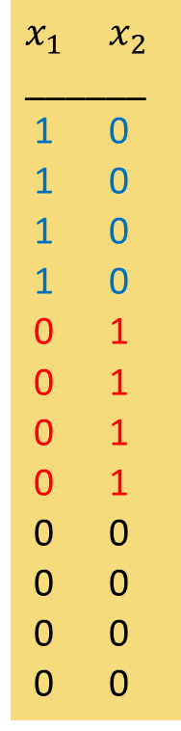

One-way ANOVA = regression with dummies
taste type
______________
1 25.44 r
2 28.10 r
3 46.46 r
4 36.96 r
5 24.83 b
6 28.47 b
7 48.15 b
8 31.78 b
9 53.42 c
10 70.87 c
11 57.07 c
12 38.08 c
$x_{1}$ $x_{2}$
______
1 0
1 0
1 0
1 0
0 1
0 1
0 1
0 1
0 0
0 0
0 0
0 0
$x_{1}$ and $x_{2}$ are dummy variables for round and beef tomatoes.
No dummy for cherry tomatoes is needed (as you will see).
Multiple regression model:
$$y=β_{0}+β_{1}x_{1}+β_{2}x_{2}+ε$$
is the same as one-way ANOVA.

Slide 15
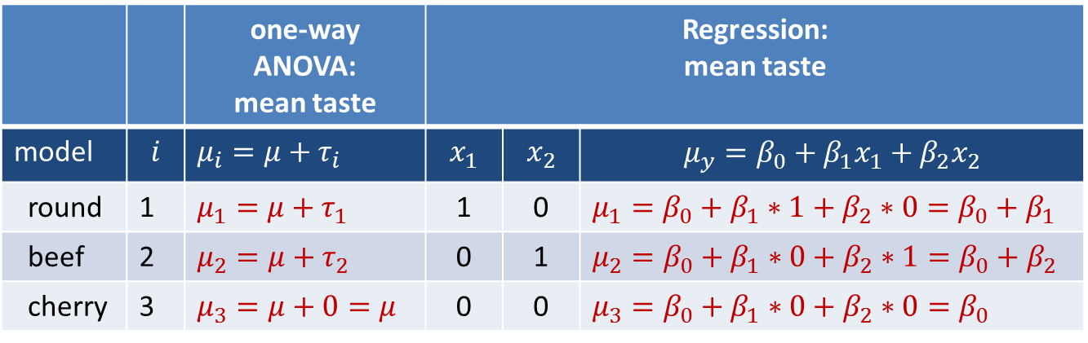
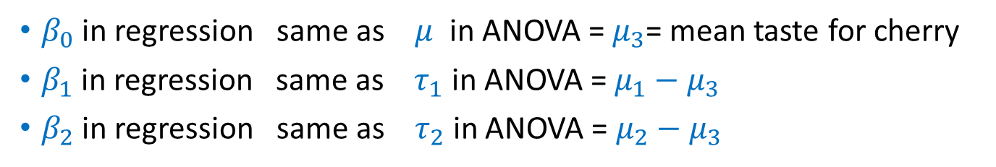
Compare parameters in ANOVA and regression
 |  | one-way ANOVA: mean taste | Regression: mean taste
model | $$i$$ | $μ_{i}=μ+τ_{i}$ | $$x_{1}$$ | $$x_{2}$$ | $$μ_{y}=β_{0}+β_{1}x_{1}+β_{2}x_{2}$$
round | 1 | $μ_{1}=μ+τ_{1}$ | 1 | 0 | $μ_{1}=β_{0}+β_{1}∗1+β_{2}∗0=β_{0}+β_{1}$
beef | 2 | $μ_{2}=μ+τ_{2}$ | 0 | 1 | $μ_{2}=β_{0}+β_{1}∗0+β_{2}∗1=β_{0}+β_{2}$
cherry | 3 | $μ_{3}=μ+0=μ$ | 0 | 0 | $μ_{3}=β_{0}+β_{1}∗0+β_{2}∗0=β_{0}$
$β_{0}$ in regression same as $μ$ in ANOVA = $μ_{3}$= mean taste for cherry
$β_{1}$ in regression same as $τ_{1}$ in ANOVA = $μ_{1}−μ_{3}$
$β_{2}$ in regression same as $τ_{2}$ in ANOVA = $μ_{2}−μ_{3}$

Slide 16
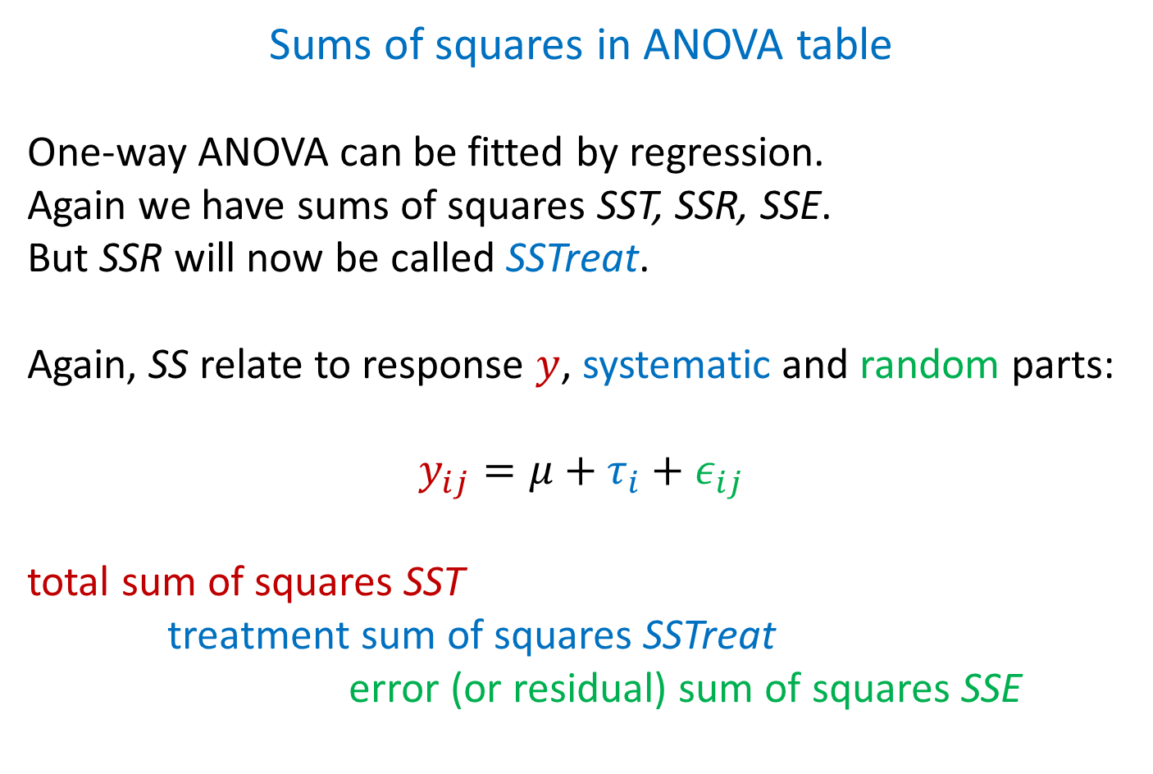
Sums of squares in ANOVA table
One-way ANOVA can be fitted by regression.
Again we have sums of squares SST, SSR, SSE.
But SSR will now be called SSTreat.
Again, SS relate to response $y$, systematic and random parts:
$$y_{ij}=μ+τ_{i}+ε_{ij}$$
total sum of squares SST
treatment sum of squares SSTreat
error (or residual) sum of squares SSE

Slide 17
ANOVA table, tomato example (in R)
Analysis of Variance Table
Response: taste
Df Sum Sq Mean Sq F value Pr(>F)
TomType 2 1187.5 593.75 4.7114 0.03981
Residuals 9 1134.2 126.02
Total 11 2322.0
SSTreat
SSE
SST
‘Tomtype’ is the name given in the R program to the factor with three levels for the types of tomato
‘ Residuals’ is how R indicates the error part
Notes:
Mention that because of rounding of data, R output will be slightly different.

Slide 18

F-test for tomato example
$F=MSR/MSE$ becomes $F=MSTreat/MSE$.
F-test was test for predictive value, $H_{0}:β_{1}=β_{2}=0.$
$β_{1},β_{2}$ in regression are the same as $τ_{1},τ_{2}$ in one-way ANOVA
So, $H_{0}:β_{1}=β_{2}=0$ is the same as $H_{0}:τ_{1}=τ_{2}\left(=τ_{3}\right)=0$.
$H_{0}:τ_{1}=τ_{2}(=τ_{3})=0$ is the same as $H_{0}:μ_{1}=μ_{2}=μ_{3}$.
This is a test whether the three types of tomato have the same population mean for sweet taste (same expected taste) or not.

Slide 19
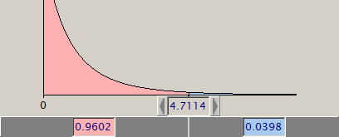
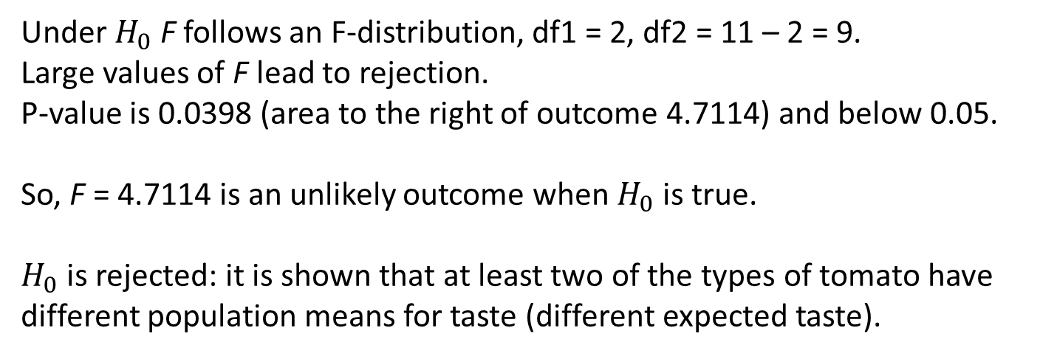
F-test for tomato example, P-value
PQRS: F-distr., df1 = 2, df2 = 9
Under $H_{0}$ F follows an F-distribution, df1 = 2, df2 = 11 – 2 = 9.
Large values of F lead to rejection.
P-value is 0.0398 (area to the right of outcome 4.7114) and below 0.05.
So, F = 4.7114 is an unlikely outcome when $H_{0}$ is true.
$H_{0}$ is rejected: it is shown that at least two of the types of tomato have different population means for taste (different expected taste).

Slide 20
What next?
F-test shows differences among the three population means for taste of the types of tomato.
Are all means different, or are two means the same and is the third different from the other two?
To find out, additionally pairwise comparisons between the three sample means are performed.

Slide 21
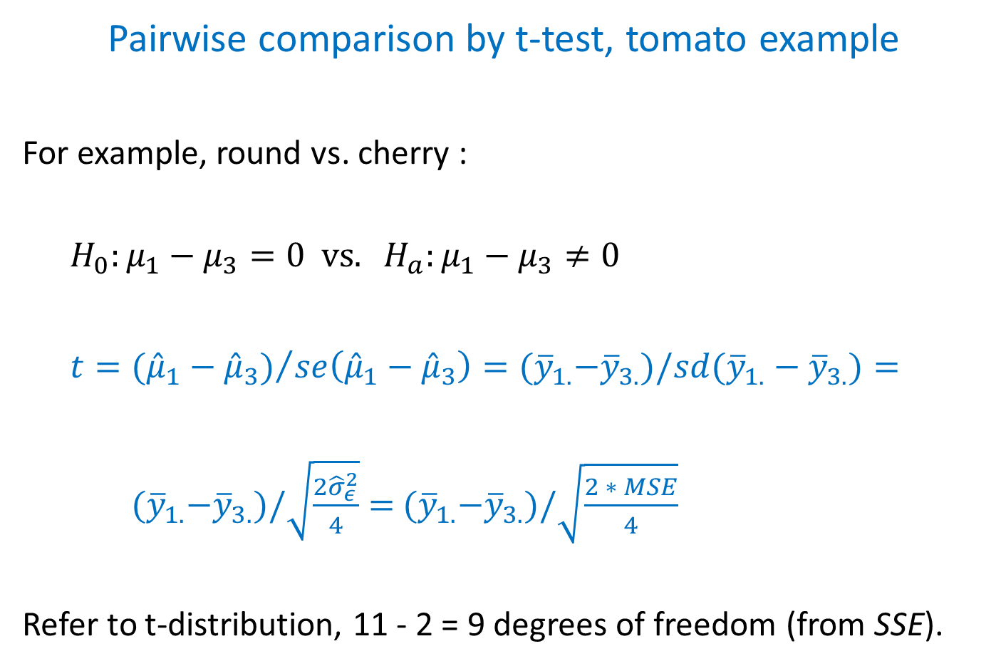
Pairwise comparison by t-test, tomato example
For example, round vs. cherry :
$H_{0}:μ_{1}−μ_{3}=0 vs. H_{a}:μ_{1}−μ_{3}≠0$
$t={({\hat{μ}}_{1}−{\hat{μ}}_{3})}/{se\left({\hat{μ}}_{1}−{\hat{μ}}_{3}\right)}={(\overline{y}}_{1.}−{\overline{y}}_{3.})/sd({\overline{y}}_{1.}−{\overline{y}}_{3.})=$
${(\overline{y}}_{1.}−{\overline{y}}_{3.})/\sqrt{\frac{2{\hat{σ}}_{ε}^{2}}{4}}=$ ${(\overline{y}}_{1.}−{\overline{y}}_{3.})/\sqrt{\frac{2 ∗ MSE}{4}}$
Refer to t-distribution, 11 - 2 = 9 degrees of freedom (from SSE).

Slide 22
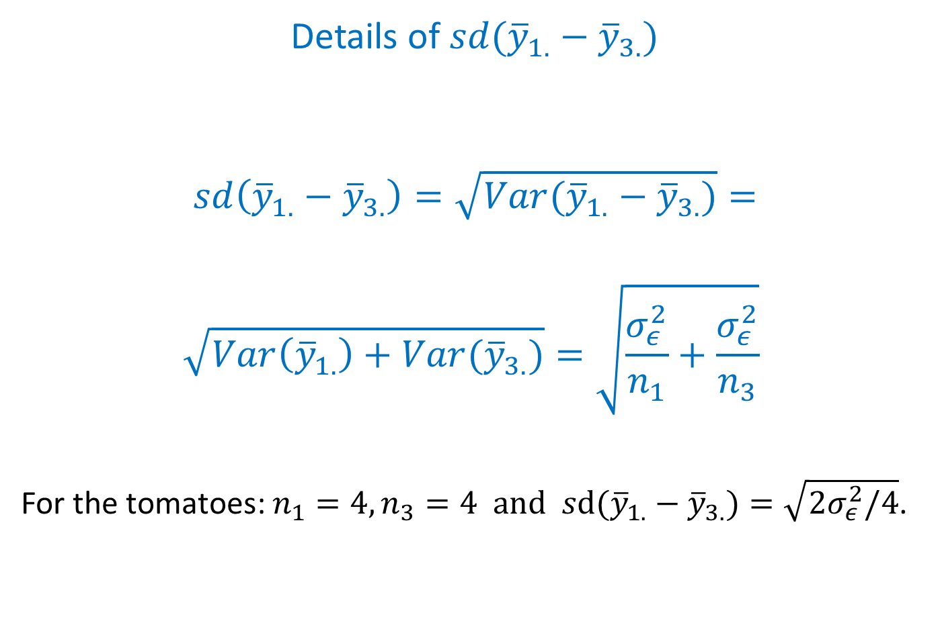
Details of $sd({\overline{y}}_{1.}−{\overline{y}}_{3.})$
$$sd\left({\overline{y}}_{1.}−{\overline{y}}_{3.}\right)=\sqrt{Var({\overline{y}}_{1.}−{\overline{y}}_{3.})}=$$
$$\sqrt{Var\left({\overline{y}}_{1.}\right)+Var({\overline{y}}_{3.})}=\sqrt{\frac{σ_{ε}^{2}}{n_{1}}+\frac{σ_{ε}^{2}}{n_{3}}}$$
For the tomatoes: $n_{1}=4, n_{3}=4 and sd({\overline{y}}_{1.}−{\overline{y}}_{3.})=\sqrt{2σ_{ε}^{2}/4}$.

Slide 23
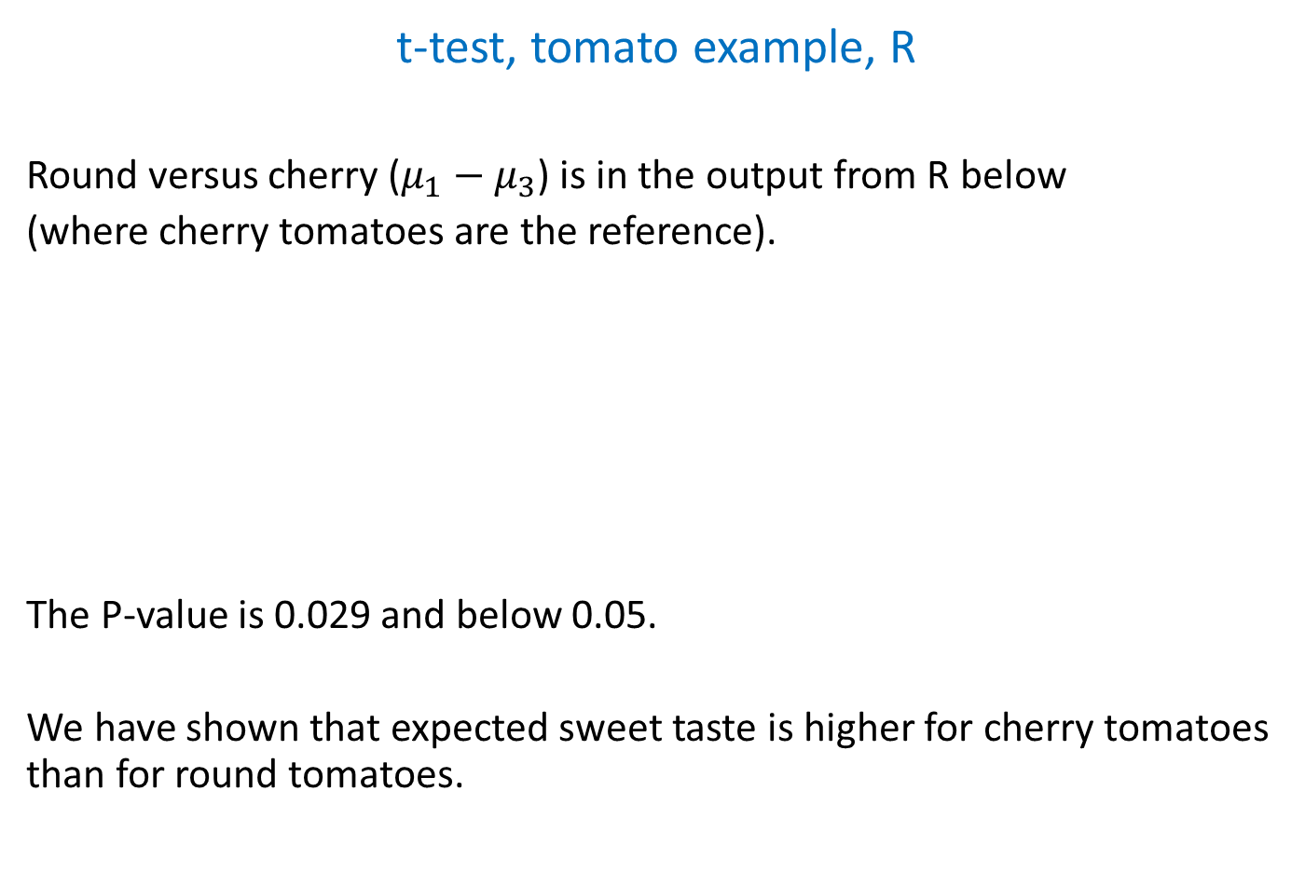
t-test, tomato example, R
Round versus cherry ($μ_{1}−μ_{3}$) is in the output from R below
(where cherry tomatoes are the reference).
The P-value is 0.029 and below 0.05.
We have shown that expected sweet taste is higher for cherry tomatoes than for round tomatoes.
Coefficients:
Estimate Std. Error t value Pr(>|t|)
(Intercept) 54.861 5.613 9.774 4.33e-06
tomtype2r -20.619 7.938 -2.598 0.0289
tomtype2b -21.555 7.938 -2.715 0.0238
Notes:
You can see that cherry tomatoes are the reference because they are not mentioned in the table. There is also the comparison beef versus cherry in the output. But round versus beef is not there.

Slide 24
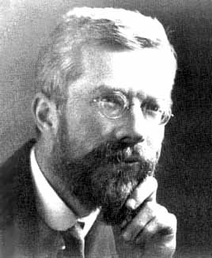
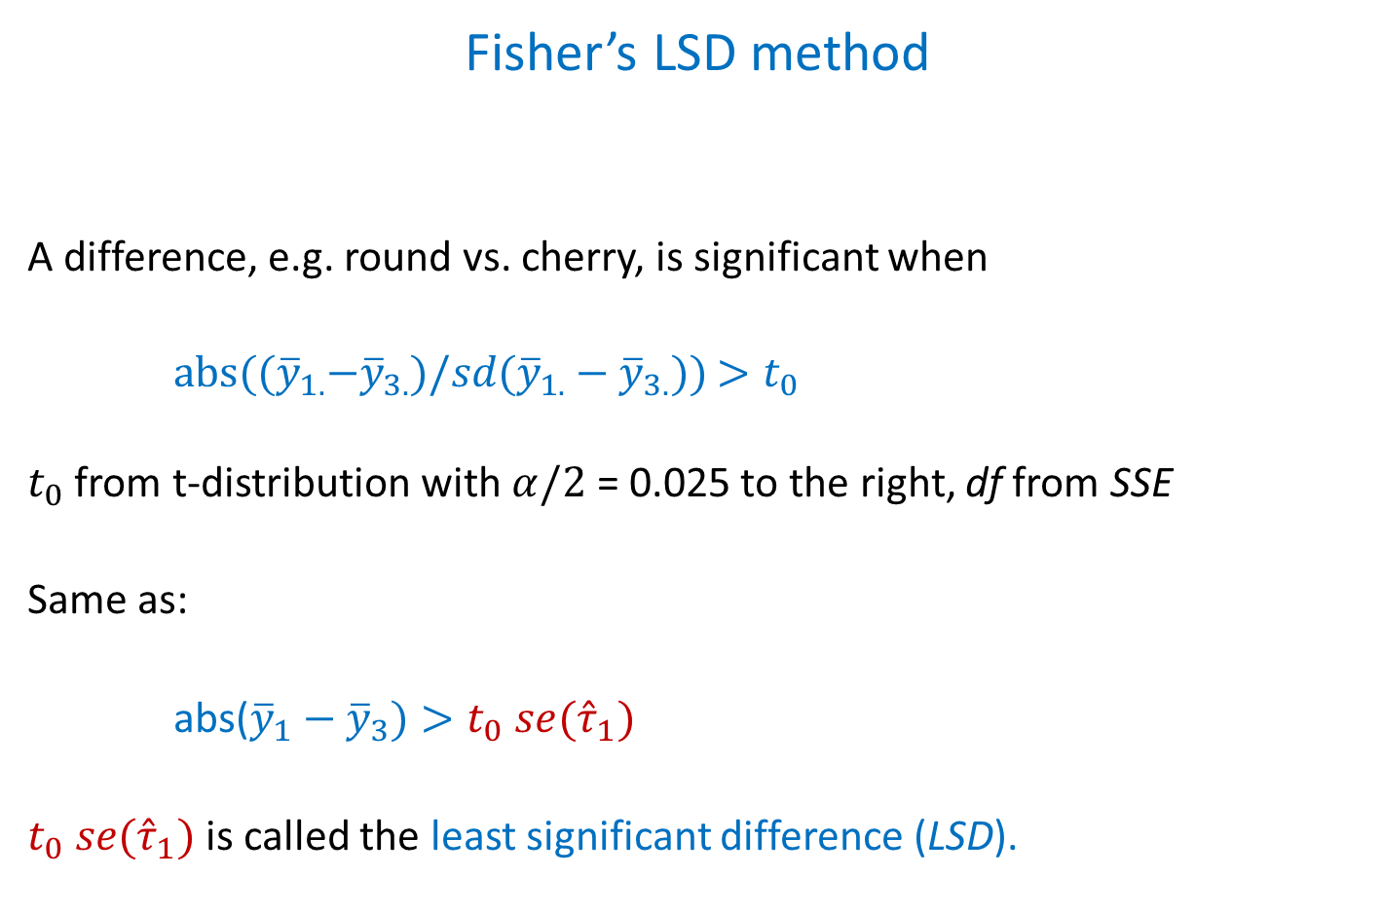
Fisher’s LSD method
A difference, e.g. round vs. cherry, is significant when
$abs({(\overline{y}}_{1.}−{\overline{y}}_{3.})/sd({\overline{y}}_{1.}−{\overline{y}}_{3.}))$ $>t_{0}$
$t_{0}$ from t-distribution with $α/2$ = 0.025 to the right, df from SSE
Same as:
abs(${\overline{y}}_{1}−{\overline{y}}_{3})>t_{0} se({\hat{τ}}_{1})$
$t_{0} se({\hat{τ}}_{1})$ is called the least significant difference (LSD).
R.A. Fisher

Slide 25
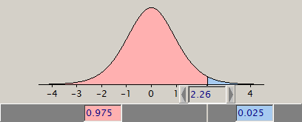
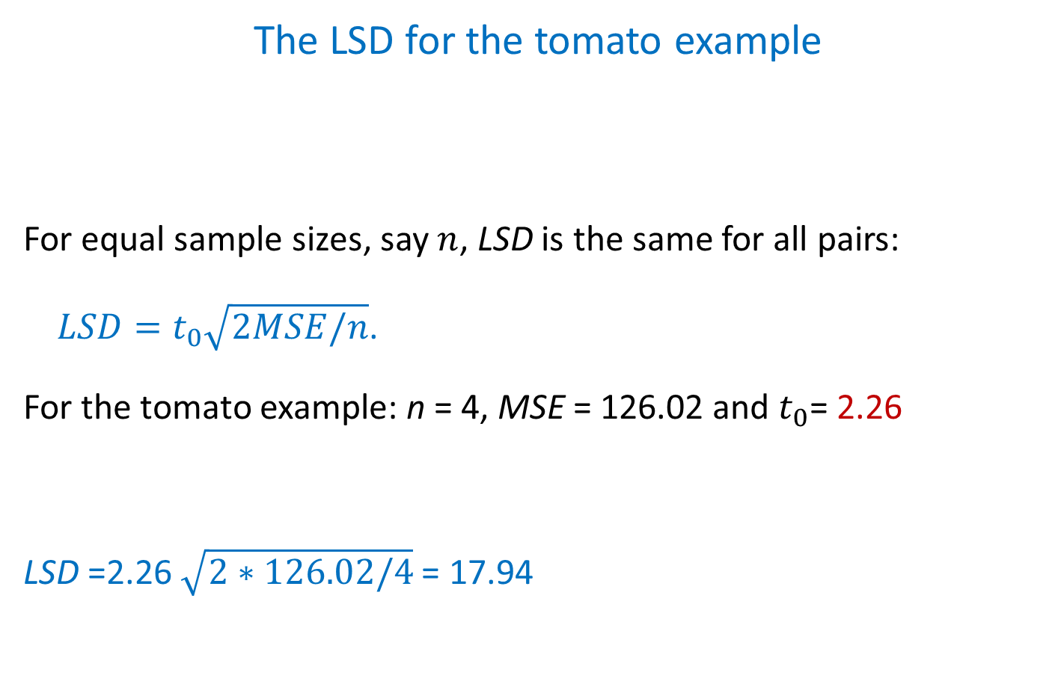
The LSD for the tomato example
For equal sample sizes, say $n$, LSD is the same for all pairs:
$LSD=t_{0}\sqrt{2MSE/n}$.
For the tomato example: n = 4, MSE = 126.02 and $t_{0}$= 2.26
LSD =2.26 $\sqrt{2∗126.02/4}$ = 17.94
t-distr. df = 9

Slide 26

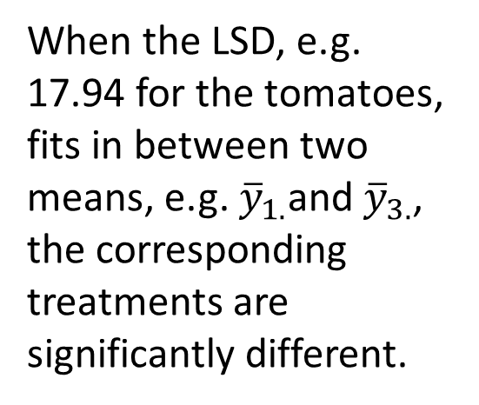
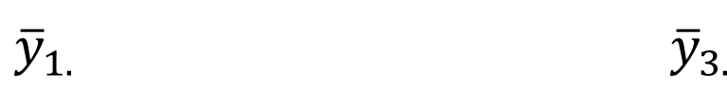
The LSD as a yardstick
When the LSD, e.g. 17.94 for the tomatoes, fits in between two means, e.g. ${\overline{y}}_{1.}$and ${\overline{y}}_{3.}$, the corresponding treatments are significantly different.
${\overline{y}}_{1.} {\overline{y}}_{3.}$

Slide 27
Fisher’s F-protected LSD
When pairwise comparisons by the LSD method are only
performed after a significant result with the F-test, the LSD
method is called F-protected.
Notes:
So, when the F test is not significant comparison stops and we conclude that no differences were shown.
NB After Tukey it is possible to find significant pairs, despite a non-significant F-test. So, protection of the F-test is relatively severe. But any pairwise comparisons after a significant F-test with the LSD are too lenient.

Slide 28
All pairwise comparisons, tomato example, R
$`emmeans`
TomType emmean SE df lower.CL upper.CL
1 34.2 5.61 9 21.5 46.9
2 33.3 5.61 9 20.6 46.0
3 54.9 5.61 9 42.2 67.6
Confidence level used: 0.95
$contrasts
contrast estimate SE df t.ratio p.value
1 - 2 0.935 7.94 9 0.118 0.9088
1 - 3 -20.619 7.94 9 -2.598 0.0289
2 - 3 -21.555 7.94 9 -2.715 0.0238
Results with Fisher’s LSD method
with routine ’emmeans’ from library ‘emmeans’

Slide 29
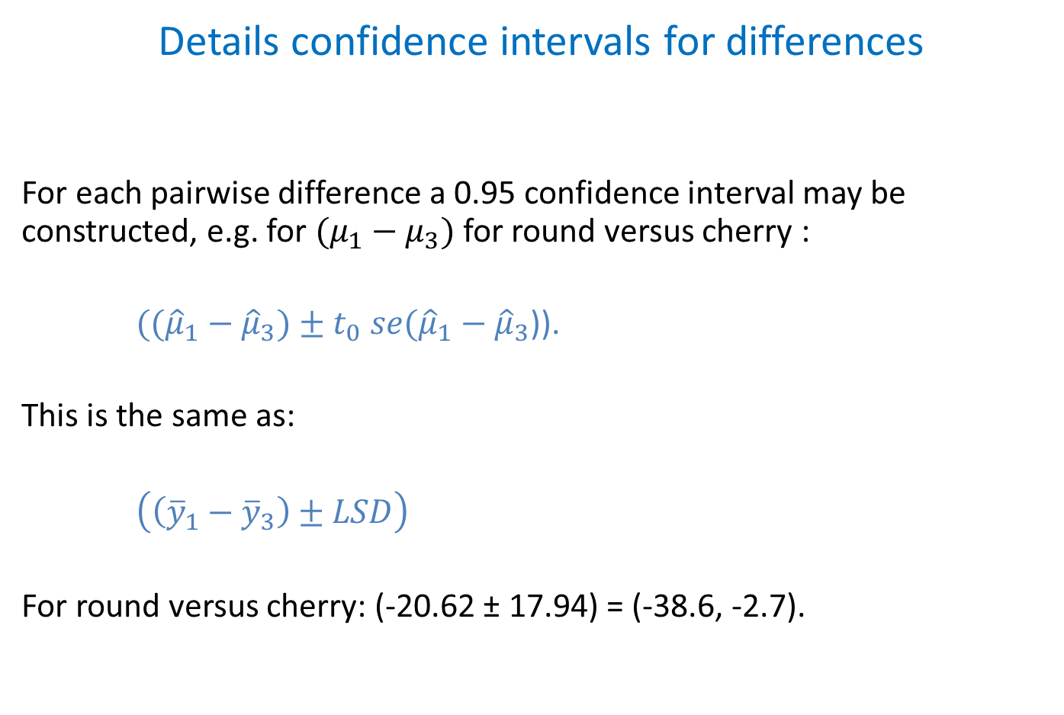
Details confidence intervals for differences
For each pairwise difference a 0.95 confidence interval may be constructed, e.g. for $(μ_{1}−μ_{3})$for round versus cherry :
$(({\hat{μ}}_{1}−{\hat{μ}}_{3})±t_{0} se({\hat{μ}}_{1}−{\hat{μ}}_{3}$)).
This is the same as:
$\left(\left({\overline{y}}_{1}−{\overline{y}}_{3}\right)±LSD\right)$
For round versus cherry: (-20.62 ± 17.94) = (-38.6, -2.7).
Notes:
Remark that 0 is not in the interval because the t-test for round versus cherry was significant.

Slide 30
Notation of significant differences, tomato example
type means
ro 34.24 a
be 33.31 a
ch 54.86 b
Common letter implies means are not significantly different.
type
ro be ch
34.24ª 33.31ª 54.86^{b}
Common superscript implies means are not significantly different.
type
be ro ch
33.31 34.24 54.86
_________________
Common underline implies means are not significantly different
(means need to be ordered from low to high).

Slide 31
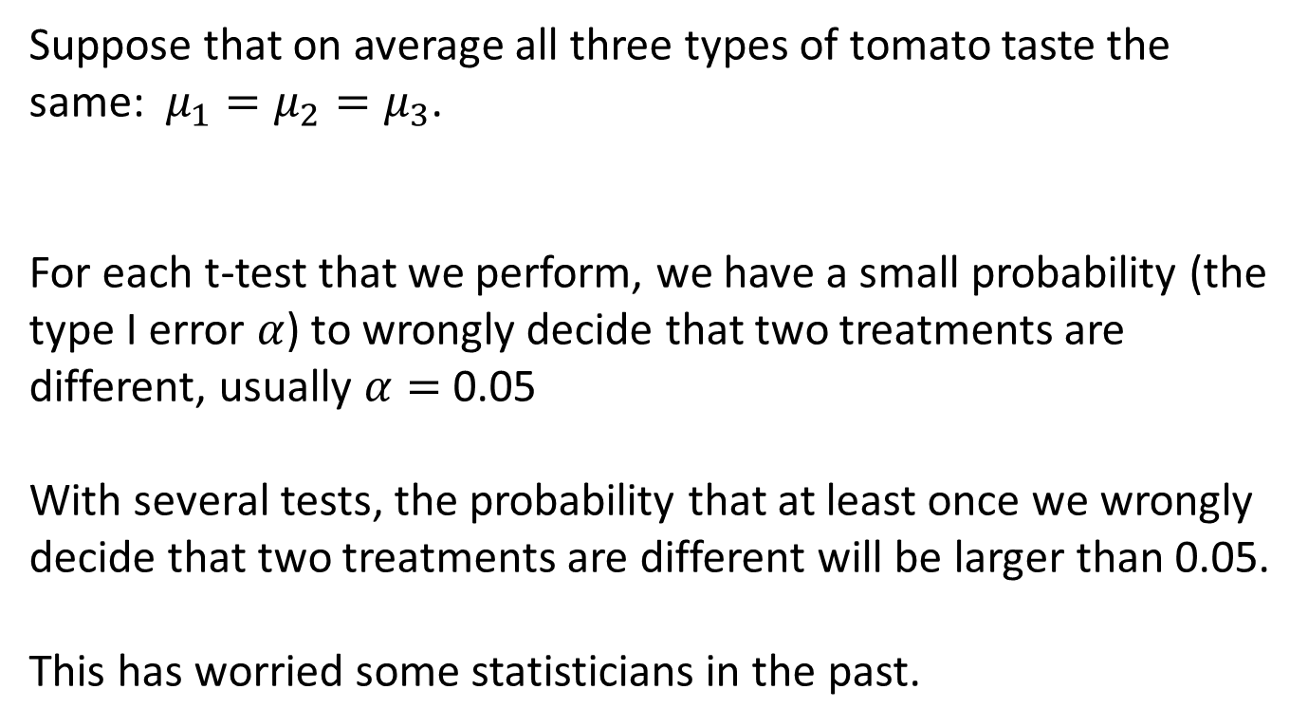
Type I error
Suppose that on average all three types of tomato taste the same: $μ_{1}=μ_{2}=μ_{3}$.
For each t-test that we perform, we have a small probability (the type I error $α$) to wrongly decide that two treatments are different, usually $α=$0.05
With several tests, the probability that at least once we wrongly decide that two treatments are different will be larger than 0.05.
This has worried some statisticians in the past.

Slide 32
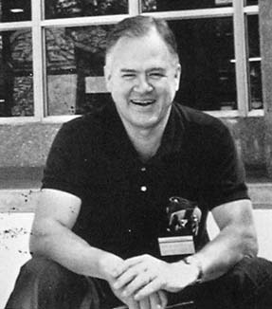
Experimentwise error
Assuming that all treatments are the same, the probability to decide at least once that two treatments are different is called the experiment wise error.
Methods have been proposed to control the experimentwise error, i.e. make sure that experimentwise error is below e.g. 0.05.
One popular method to do so
is Tukey’s range test.
John Wilder Tukey
John Wilder Tukey

Slide 33
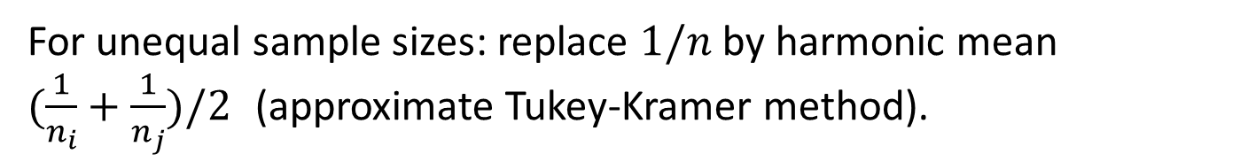
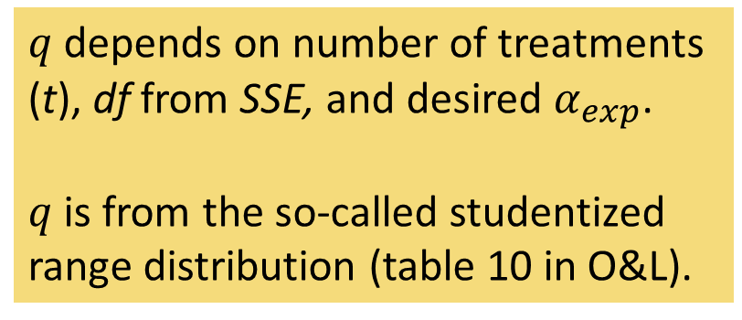
Tukey’s range test
Two treatments differ significantly, when the difference between their sample means exceeds yardstick W.
$q$ depends on number of treatments (t), df from SSE, and desired $α_{exp}$.
$q$ is from the so-called studentized range distribution (table 10 in O&L).
For unequal sample sizes: replace $1/n$ by harmonic mean $(\frac{1}{n_{i}}+\frac{1}{n_{j}})/2$ (approximate Tukey-Kramer method).
Notes:
Harmonic mean toelichten. We nemen dus niet een gemiddelde van $n_{i}$ en $n_{j}$ voor n, maar een gemiddelde van $1/n_{i}$ en $1/n_{j}$ voor 1/n. Dat blijkt beter te werken. Wijs er op dat t.o.v. de LSD de 2 onder de wortel ontbreekt.

Slide 34
Two way ANOVA

Slide 35
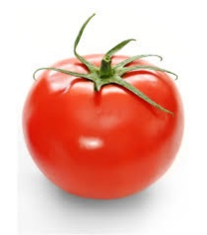

Taste of tomatoes revisited
taste type
_______________
1 46.46 r
2 36.96 r
3 25.44 r
4 28.10 r
5 48.15 b
6 31.78 b
7 24.83 b
8 28.47 b
9 57.07 c
10 70.87 c
11 53.42 c
12 38.08 c
ripe
___
lo
lo
sh
sh
lo
lo
sh
sh
lo
lo
sh
sh
Response $y$ = sweet taste
Two factors now:
Type of tomato:
beef, cherry or round tomatoes.
Ripening duration: long or short.
How to handle two factors together?

Slide 36
Exploring structure in treatments
We want to explore the structure in the 6 treatments.
For instance, is the effect of ripening the same for the three types of tomato?
If so, we can say something about ripening without having to bother about the type of tomato.
If not, we have to describe the effect of ripening for each type of tomato separately.

Slide 37
Interaction
When the effect of ripening depends upon the type of tomato, we say that there is interaction between the experimental factors for tomato type and ripening.
We want to know more about interaction.
The one-way ANOVA is of little use in this respect, because it does not explore the structure of the treatments.

Slide 38
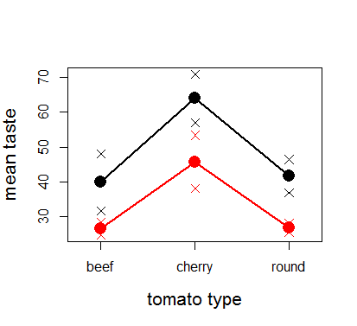
A profile plot for the tomato example
calculate the 6 sample means
plot means vs. type, showing levels of ripe
connect points for same level of ripe
profile plot suggests no interaction
 | ripe
type | lo | sh
b | 39.97 | 26.65
c | 63.97 | 45.75
r | 41.71 | 26.77
Notes:
Separate data have been included as well, but are usually omitted

Slide 39
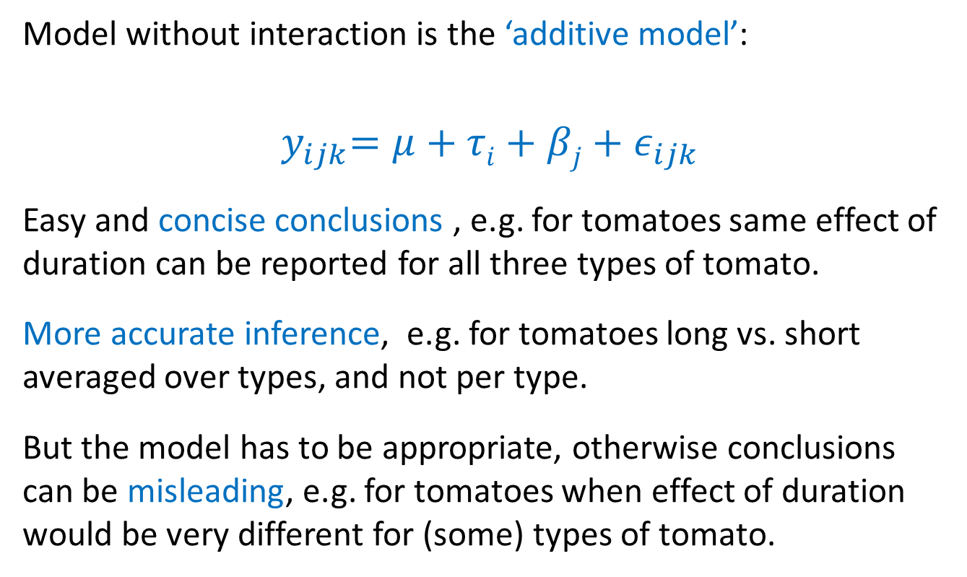
Two-way ANOVA model without interaction
Model without interaction is the ‘additive model’:
$${ y}_{ijk}=μ+τi+βj+ε_{ijk}$$
Easy and concise conclusions , e.g. for tomatoes same effect of duration can be reported for all three types of tomato.
More accurate inference, e.g. for tomatoes long vs. short averaged over types, and not per type.
But the model has to be appropriate, otherwise conclusions can be misleading, e.g. for tomatoes when effect of duration would be very different for (some) types of tomato.

Slide 40
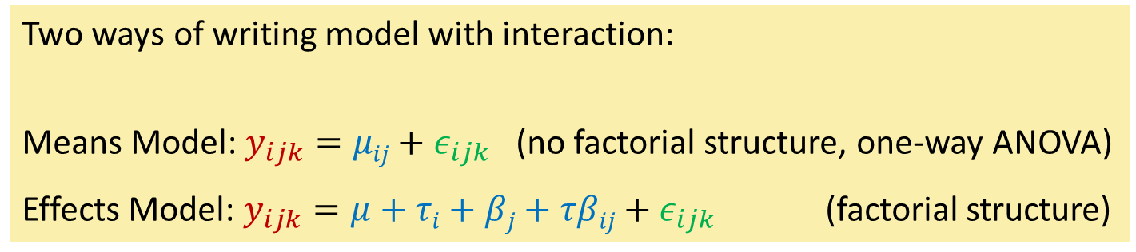
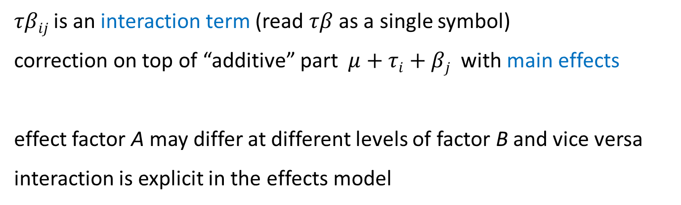
Two-way ANOVA model with interaction
Two ways of writing model with interaction:
Means Model: $y_{ijk}=μij+ε_{ijk}$ (no factorial structure, one-way ANOVA)
Effects Model: $y_{ijk}=μ+τi+βj+τβij+ε_{ijk}$ (factorial structure)
$τβij$ is an interaction term (read $τβ$ as a single symbol)
correction on top of “additive” part $μ+τi+βj$ with main effects
effect factor A may differ at different levels of factor B and vice versa
interaction is explicit in the effects model

Slide 41
Effects model with interaction, tomato example
$$y_{ijk}=μ+αi+βj+αβij+ε_{ijk}$$
 | ripe
type | lo | sh
b | 39.97 | 26.65
c | 63.97 | 45.75
r | 41.71 | 26.77
 | ripe
type | lo | sh
b | μ+τ₁+β₁+τβ₁₁ | μ+τ₁+β₂+τβ₁₂
c | μ+τ₂+β₁+τβ₂₁ | μ+τ₂+β₂+τβ₂₂
r | μ+τ₃+β₁+τβ₃₁ | μ+τ₃+β₂+τβ₃₂
sample means ${\overline{y}}_{ij.}$estimates for population means $μij=μ+τi+βj+τβij$
Notes:
R by default orders levels of a factor alphabetically, e.g. b, c, r.

Slide 42
Effects model with interaction, tomato example
$$y_{ijk}=μ+αi+βj+αβij+ε_{ijk}$$
 | ripe
type | lo | sh
b | μ+τ₁+β₁+τβ₁₁ | μ+τ₁+β₂+τβ₁₂
c | μ+τ₂+β₁+τβ₂₁ | μ+τ₂+β₂+τβ₂₂
r | μ+τ₃+β₁+τβ₃₁ | μ+τ₃+β₂+τβ₃₂
we have 1 + 3 + 2 + 6 = 12 parameters.
but we need only six parameters to represent six population means
Notes:
R by default orders levels of a factor alphabetically, e.g. b, c, r.

Slide 43

Cornerstone representation – step 1
 | ripe
type | lo | sh
b | μ+τ₁+β₁+τβ₁₁ | μ+τ₁+β₂+τβ₁₂
c | μ+τ₂+β₁+τβ₂₁ | μ+τ₂+β₂+τβ₂₂
r | μ+τ₃+β₁+τβ₃₁ | μ+τ₃+β₂+τβ₃₂
 | ripe
type | lo | sh
b | μ | μ
c | μ | μ
r | μ | μ
R would take beef & long as a reference (ordering levels alphabetically)
$μ$ is the population mean for type beef and duration long

Slide 44

Cornerstone representation – step 2
 | ripe
type | lo | sh
b | μ+τ₁+β₁+τβ₁₁ | μ+τ₁+β₂+τβ₁₂
c | μ+τ₂+β₁+τβ₂₁ | μ+τ₂+β₂+τβ₂₂
r | μ+τ₃+β₁+τβ₃₁ | μ+τ₃+β₂+τβ₃₂
 | ripe
type | lo | sh
b | μ | μ + β₂
c | μ +τ₂ | μ +τ₂ +β₂
r | μ +τ₃ | μ +τ₃ +β₂
use main effects $τ_{2},τ_{3},β_{2}$ for population means in 1st row & 1st column
no need for $τ_{1}$, $β_{1}$, i.e. $τ_{1}=0,β_{1}=0$

Slide 45

Cornerstone representation – step 3
 | ripe
type | lo | sh
b | μ+τ₁+β₁+τβ₁₁ | μ+τ₁+β₂+τβ₁₂
c | μ+τ₂+β₁+τβ₂₁ | μ+τ₂+β₂+τβ₂₂
r | μ+τ₃+β₁+τβ₃₁ | μ+τ₃+β₂+τβ₃₂
 | ripe
type | lo | sh
b | μ | μ + β₂
c | μ +τ₂ | μ +τ₂ +β₂ +τβ₂₂
r | μ +τ₃ | μ +τ₃ +β₂ +τβ₃₂
interactions $τβ_{22}, τβ_{32},$on top of main effects, for remaining two means
no need for interactions in 1st row & 1st column, i.e. $τβ_{11}=τβ_{12}=τβ_{21}=τβ_{31}=0$

Slide 46

Cornerstone representation
 | ripe
type | lo | sh
b | μ+τ₁+β₁+τβ₁₁ | μ+τ₁+β₂+τβ₁₂
c | μ+τ₂+β₁+τβ₂₁ | μ+τ₂+β₂+τβ₂₂
r | μ+τ₃+β₁+τβ₃₁ | μ+τ₃+β₂+τβ₃₂
 | ripe
type | lo | sh
b | μ | μ + β₂
c | μ +τ₂ | μ +τ₂ +β₂ +τβ₂₂
r | μ +τ₃ | μ +τ₃ +β₂ +τβ₃₂
$μ, τ_{2},τ_{3},β_{2},τβ_{22},τβ_{32}$ are left to reproduce six means exactly

Slide 47




Estimates with cornerstone representation -1
 | ripe
type | lo | sh
b | 39.97 | 26.65
c | 63.97 | 45.75
r | 41.71 | 26.77
 | ripe
type | lo | sh
b | μ | μ+ β₂
c | μ+τ₂ | μ+τ₂+β₂+τβ₂₂
r | μ+τ₃ | μ+τ₃+β₂+τβ₃₂
$\hat{μ}$ is sample mean taste beef / long: 39.97
${\hat{τ}}_{2}$ is taste difference of cherry vs beef after long ripening: 63.97 − 39.97 = 24.00
 | ripe
type | lo | sh
b | 39.97 | 39.97 -13.32
c | 39.97+24.00 | 39.97+24.00-13.32
r | 39.97+ 1.74 | 39.97+ 1.74-13.32
${\hat{τ}}_{3}$is taste difference of round vs beef after long ripening: 41.71 − 39.97 = 1.74
${\hat{β}}_{2}$ is taste diff of short vs long ripening for beef tomatoes: 26.65 − 39.97 = − 13.32
We have reproduced the sample means in the 1st row and 1st column.
But the two means in the lower right corner are not OK yet.

Slide 48
Estimates with cornerstone representation - 2
 | ripe
type | lo | sh
b | 39.97 | 26.65
c | 63.97 | 45.75
r | 41.71 | 26.77
 | ripe
type | lo | sh
b | μ | μ+ β₂
c | μ+τ₂ | μ+τ₂+β₂+τβ₂₂
r | μ+τ₃ | μ+τ₃+β₂+τβ₃₂
 | ripe
type | lo | sh
b | 39.97 | 39.97 -13.32
c | 39.97+24.00 | 39.97+24.00-13.32-4.90
r | 39.97+ 1.74 | 39.97+ 1.74-13.32-1.62
We use the interaction terms to reproduce the last two means
$\hat{τβ_{22}}$ added to $\hat{μ}+{\hat{τ}}_{2}+{\hat{β}}_{2}$ for mean of cherry-short: 45.75 − (39.97 + 24.00 - 13.32) = −4.90 .
$\hat{τβ_{32}}$ added to $\hat{μ}+{\hat{τ}}_{3}+{\hat{β}}_{2}$ for mean of round-short: 26.77− (39.87 + 1.74 - 13.32) = −1.62

Slide 49
More about the cornerstone representation
Different statistical software may choose a different level as a reference, usually by default the first or the last level of a factor.
By default R takes the first level (after alphabetical ordering)
Other side conditions than corner-stone are possible, such as the sum-to-zero condition, but have become more rare.
In all cases, interaction parameters are of first interest.

Slide 50

F-test in means model
Means model: ${\underline{y}}_{ijk}=μij+{\underline{ε}}_{ijk}$ essentially a one-way ANOVA
Analysis of Variance Table
Response: taste
Df Sum Sq Mean Sq F value Pr(>F)
type:ripe 5 1919.88 383.98 5.7288 0.028
Residuals 6 402.15 67.03
R output
H₀: $μ11=$ $μ12=$ $μ21=$ $μ22=$ $μ31=$ $μ32$ vs. H_{a}: at least two means different
P-value = 0.028 < 0.05, reject H₀, some means differ.
Due to type, ripe, and / or their interaction?
6 – 1 = 5 df, because 6 (= 3 * 2) treatments

Slide 51

Splitting up SSTreat
${\underline{y}}_{ijk}=μ+τi+βj+τβij+{\underline{ε}}_{ijk}$, ${\underline{ε}}_{ijk}$∼ $N\left(0,σ_{ε}^{2}\right),$ind.
We want an F-test for interaction.
Therefore, we split SSTreat into three separate SS:
SSA SS for main effects A
SSB SS for main effects B
SSAB SS for interaction between A and B
SSTreat = SSA + SSB + SSAB
Notes:
Explain that we want a separate sum of squares for interaction to use in the F-test.

Slide 52

Splitting SSTreat, tomato example
We start with the SS for interaction.
Compare SSEs from models with and without interaction:
CM : $y_{ijk}=μ+τi+βj+τβij+ε_{ijk}$ (interaction model)
RM: $y_{ijk}=μ+τi+βj +ε_{ijk}$ (additive model)
> CM.ia <- lm(taste ~ type + ripe + type:ripe)
> deviance(CM.ia)
[1] 402.1538
> RM.ia <- lm(taste ~ type + ripe)
> deviance(RM.ia)
[1] 414.6399
> SS.ia <- deviance(RM.ia)-deviance(CM.ia)
[1] 12.48602
So: SStype x ripe = 414.6399 – 402.1538 = 12.49

Slide 53


Splitting SSTreat, tomato example
SS for main effect of type
Restrict attention to additive model
CM : $y_{ijk}=μ+τi+βj+ε_{ijk}$
RM: $y_{ijk}=μ+ βj+ε_{ijk}$
> CM.m1 <- lm(taste ~ type + ripe)
> deviance(CM.m1)
[1] 414.6399
> RM.m1 <- lm(taste ~ ripe)
> deviance(RM.m1)
[1] 1602.059
> SS.type <- deviance(RM.m1)-deviance(CM.m1)
[1] 1187.419
SS for main effect of ripe
Restrict attention to additive model
CM : $y_{ijk}=μ+τi+βj+ε_{ijk}$
RM: $y_{ijk}=μ+τi +ε_{ijk}$
> CM.m2 <- lm(taste ~ type + ripe)
> deviance(CM.m2)
[1] 414.6399
> RM.m2 <- lm(taste ~ type)
> deviance(RM.m2)
[1] 1134.615
> SS.ripe <- deviance(RM.m2)-deviance(CM.m2)
[1] 719.975
So: SStype = 1187.42 and SSripe = 719.98
SStype+SSripe+SStype x ripe =1187.42+719.98+12.49 = 1919.88 = SSTreat
Notes:
Already mention that SS constructed like this are called type II SS.

Slide 54

Default steps to make SS in R
> anova(lm(taste ~ type + ripe + type:ripe))
Analysis of Variance Table
Response: taste
Df Sum Sq Mean Sq F value Pr(>F)
type 2 1187.42 593.71 8.8579 0.0162
ripe 1 719.98 719.98 10.7418 0.0169
type:ripe 2 12.49 6.24 0.0931 0.9124
Residuals 6 402.15 67.03
SS are: type I SS = accumulated SS = sequential SS
In the R table SS are constructed like this:
$y_{ijk}=μ+ε_{ijk}$
$y_{ijk}=μ+τi+ε_{ijk}$
$y_{ijk}=μ+τi+βj+ε_{ijk}$
$y_{ijk}=μ+τi+βj+τβij+ε_{ijk}$
+ type
→1187.42
+ ripe
→719.98
+ type x ripe
→12.49
Notes:
SS constructed like this are called type I SS. Same result as before, because the design is balanced (equal numbers of tomatoes per combination of type and ripe).

Slide 55

F-test for interaction
> anova(lm(taste ~ type + ripe + type:ripe))
Analysis of Variance Table
Response: taste
Df Sum Sq Mean Sq F value Pr(>F)
type 2 1187.42 593.71 8.8579 0.0162
ripe 1 719.98 719.98 10.7418 0.0169
type:ripe 2 12.49 6.24 0.0931 0.9124
Residuals 6 402.15 67.03
$H_{0}:τβ11=τβ12$ $=…=τβ32=0$ versus $H_{a}:$ not all $τβij=0$
test statistic: $F=\frac{MStype×ripe}{MSE}=\frac{6.24}{67.030}=0.093$
P-value = 0.91 > 0.05, from F-distr., df1 = 2, df2 = 6, do not reject H₀
effect of ripening upon expected sweetness cannot be shown to be different across tomato types and vice versa
additive model can be assumed (Occam’s razor)
Notes:
Mention Occam’s razor.

Slide 56

F-tests for main effects, type
> anova(lm(taste ~ type + ripe + type:ripe))
Analysis of Variance Table
Response: taste
Df Sum Sq Mean Sq F value Pr(>F)
type 2 1187.42 593.71 8.8579 0.0162
ripe 1 719.98 719.98 10.7418 0.0169
type:ripe 2 12.49 6.24 0.0931 0.9124
Residuals 6 402.15 67.03
$H_{0}:τ1=τ2$ $=τ3=0$ vs. $H_{a}:$ not all $τ_{i}=0$
Test statistic: $F=\frac{MStype}{MSE}=8.86$
P-value $=0.016<0.05$, from F-distr. df1 = 2, df2 = 6, reject H₀, expected sweetness differs among types (irrespective of ripe)

Slide 57

F-tests for main effects, ripe
> anova(lm(taste ~ type + ripe + type:ripe))
Analysis of Variance Table
Response: taste
Df Sum Sq Mean Sq F value Pr(>F)
type 2 1187.42 593.71 8.8579 0.0162
ripe 1 719.98 719.98 10.7418 0.0169
type:ripe 2 12.49 6.24 0.0931 0.9124
Residuals 6 402.15 67.03
$H_{0}:β1=β2=0$ vs. $H_{a}:$ not all $βj≠0$
Test statistic: $F=\frac{MSripe}{MSE}=10.74$
P-value $=0.017<0.05$, from F-distr. df1 = 1, df2 = 6, reject H₀, expected sweetness differs between long and short ripening (irrespective of type)

Slide 58
What comes after the F-tests in two-way ANOVA?
For example, in an experiment about weight loss with two factors for three diets and two sexes, how do we proceed after the F-test for interaction?
We perform pairwise comparisons of means.
For instance with Fisher’s LSD method or Tukey’s range test.
Which table(s) of means we inspect depends upon the outcome of the test for interaction.
Notes:
Stress that choice of table of means depends upon outcome of F-test for interaction.
So, either one table of combination of levels of factors a and b, or two separate tables, one with means for factor A, the other with means for factor B.

